Slide 1
Training, Validation, and Testing
CSCI 4150/6050: Computer Vision
Some of the slides are from
Professor David Wingate (BYU)

Slide 2
Things that could go wrong…
Stopping at a local minimum
  Solution: Choosing a good optimizer and learning rate
Weight explosion
  Solution: Proper initialization and regularization
Overfitting
  Solution: Data augmentation and validation sets

Slide 3
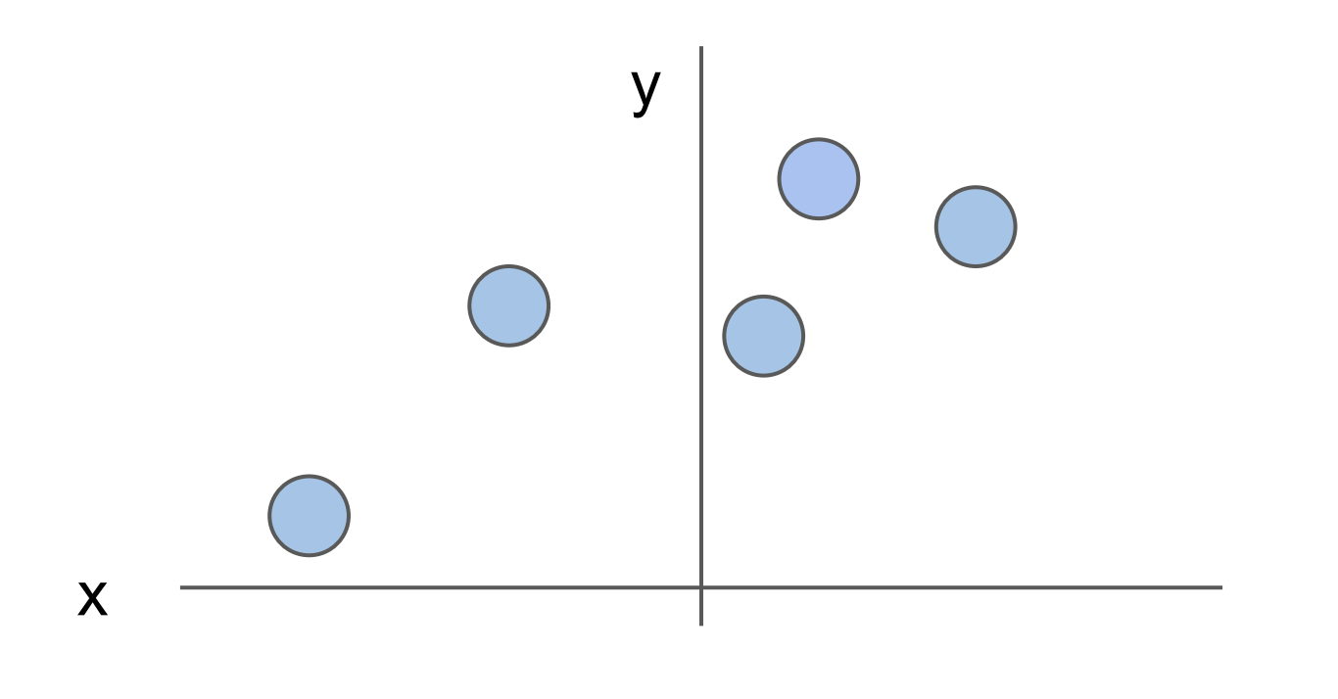
What is overfitting?

Slide 4
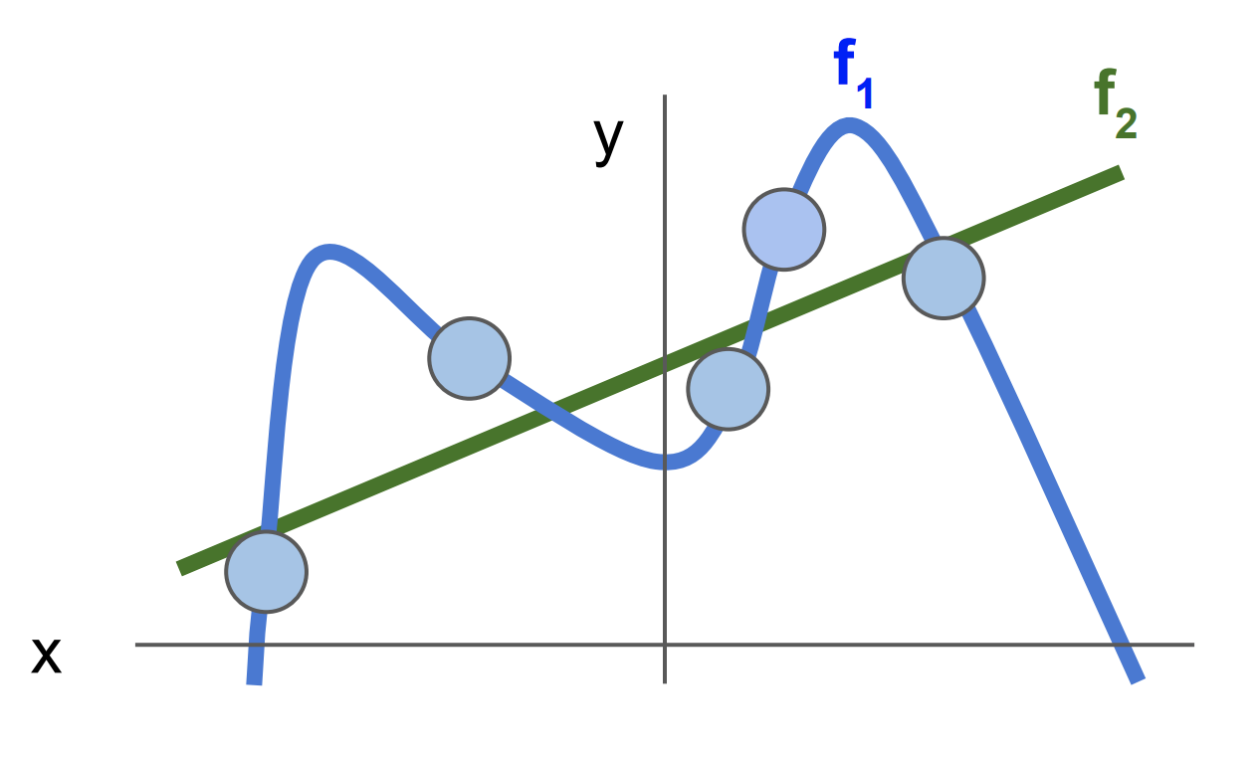
What is overfitting?

Slide 5
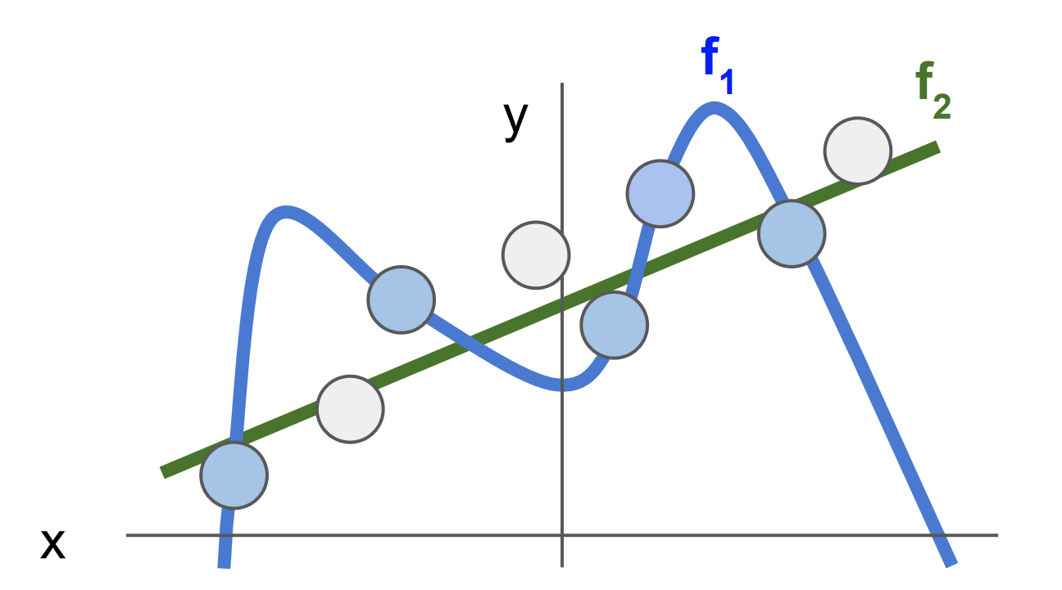
What is overfitting?
Overfitting occurs when the network matches the noise in the data too well, missing the general pattern.

Slide 6
A network that is too big or trained for too long has the potential to overfit. How do we fix this??

Slide 7
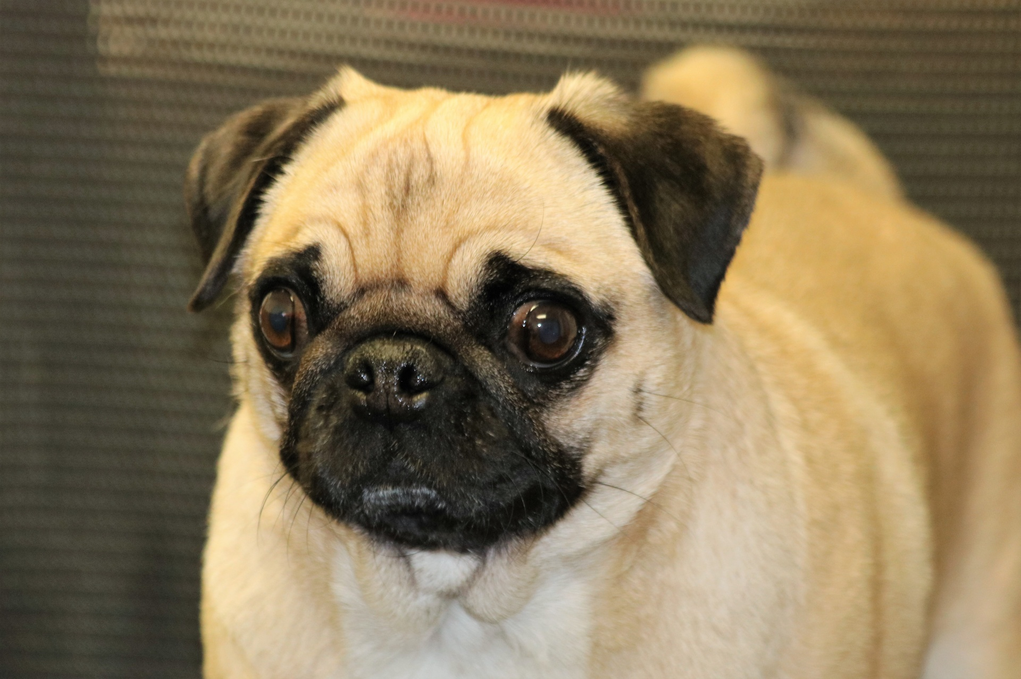
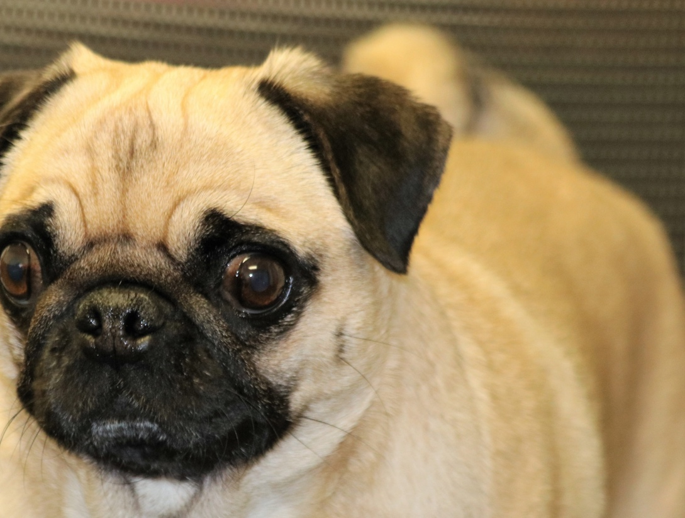

Data Augmentation
Do the network does not memorise the data. Introduce variations of the image, if the parameters are reduced too much as well to prevent overfitting
Then it may underfit.
Data Augmentation is the process of modifying the data you already have to provide more examples to the
Prevents the memorisation problem
Common techniques include
  Random cropping and scaling
  Mirroring horizontally
  Adding noise

Slide 8
Validation Sets
Training loss by itself cannot tell us when overfitting starts to occur, the validation set tells us when the memorising starts so we can cut off the training as the loss begins to rise again.
The validation set is a separate from the training and testing set.
Analyzing the results on the validation set is one way to ensure that the network is not overfitting.
Loss vs time (x axis)
Validation
Training

Slide 9
Checkpoints
Eg after every epoch, ie after the model has trained on the data once.
Checkpoints are times when you save the weights (and relevant training info) for a neural network.
Has primarily two uses:
  Prevents having to train from scratch if the machine stops unexpectedly.
  Allows for saving weights that perform best on the validation set, rather than the final training weights.
Validation
Training
I’ll save these weights!

Slide 10
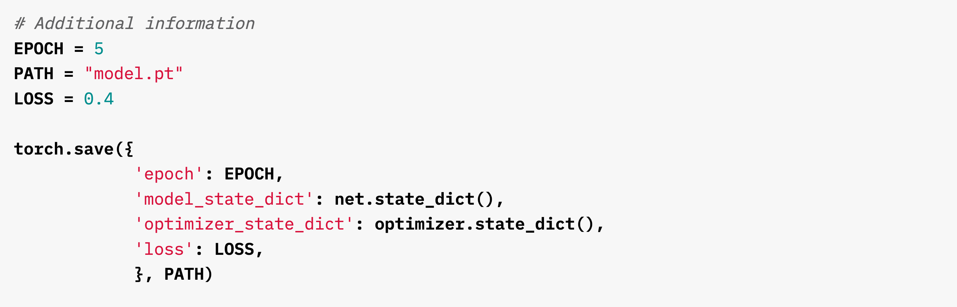
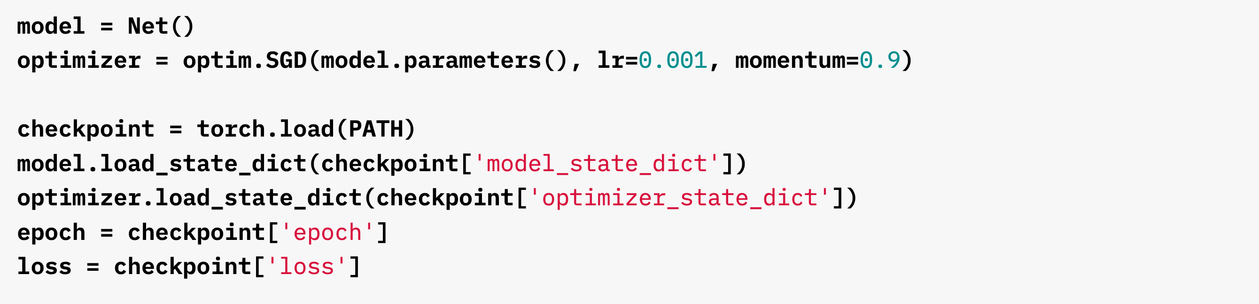
Checkpoints

Slide 11
The Three Data Sets
Training Data – Data that the neural network can use to modify the network weights through the loss function. Generally 60%-80% of the total data.
Validation Data– Data that can be used to determine when to save the networks weights. The weights that do the best of the validation data are the ones that are saved. Generally 10%-20% of the total data.
Testing Data – Data that cannot be used to inform the network in any way. Only final metrics are reported to allow for fair comparison. Generally 10%-20% of total data.

Slide 12
What if I’m only given unsplit data?
If you’re given unsplit data, a good rule of thumb is to split it as
70% / 10% / 20%
Training / Validation / Testing
If you are only given training and testing data, split the training data into an 80% training set and 20% validation set.

Slide 13
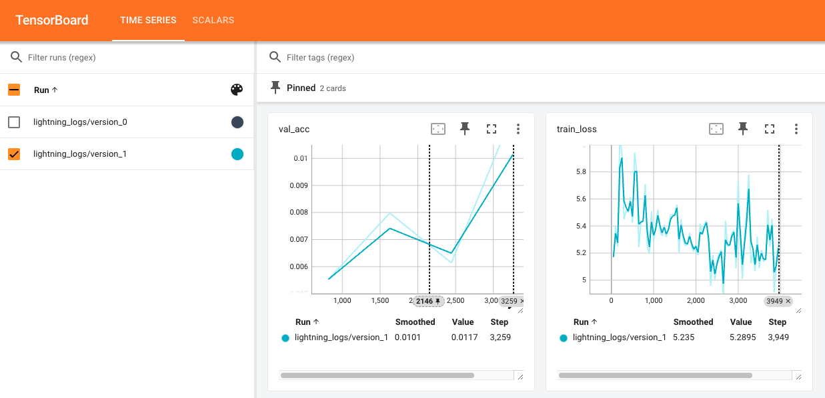
Visualizing the Results

Slide 14
Visualizing the Results
There are many “logger” packages that can keep track of loss values, accuracies, and checkpoints for you.
A common one is Tensorboard, which runs an interactive HTML page while the network is training.
  tensorboard --logdir ./my_logs
  Go to localhost:6006 on your web browser

Slide 15

Streamlining the Process…

Slide 16
PyTorch Lightning
PyTorch Lighting is a Python package that is designed to run PyTorch code.
It has a streamlined and consistent setup that simplifies the training pipeline.
It has a lots of built-in features that make it easy to customize.

Slide 17
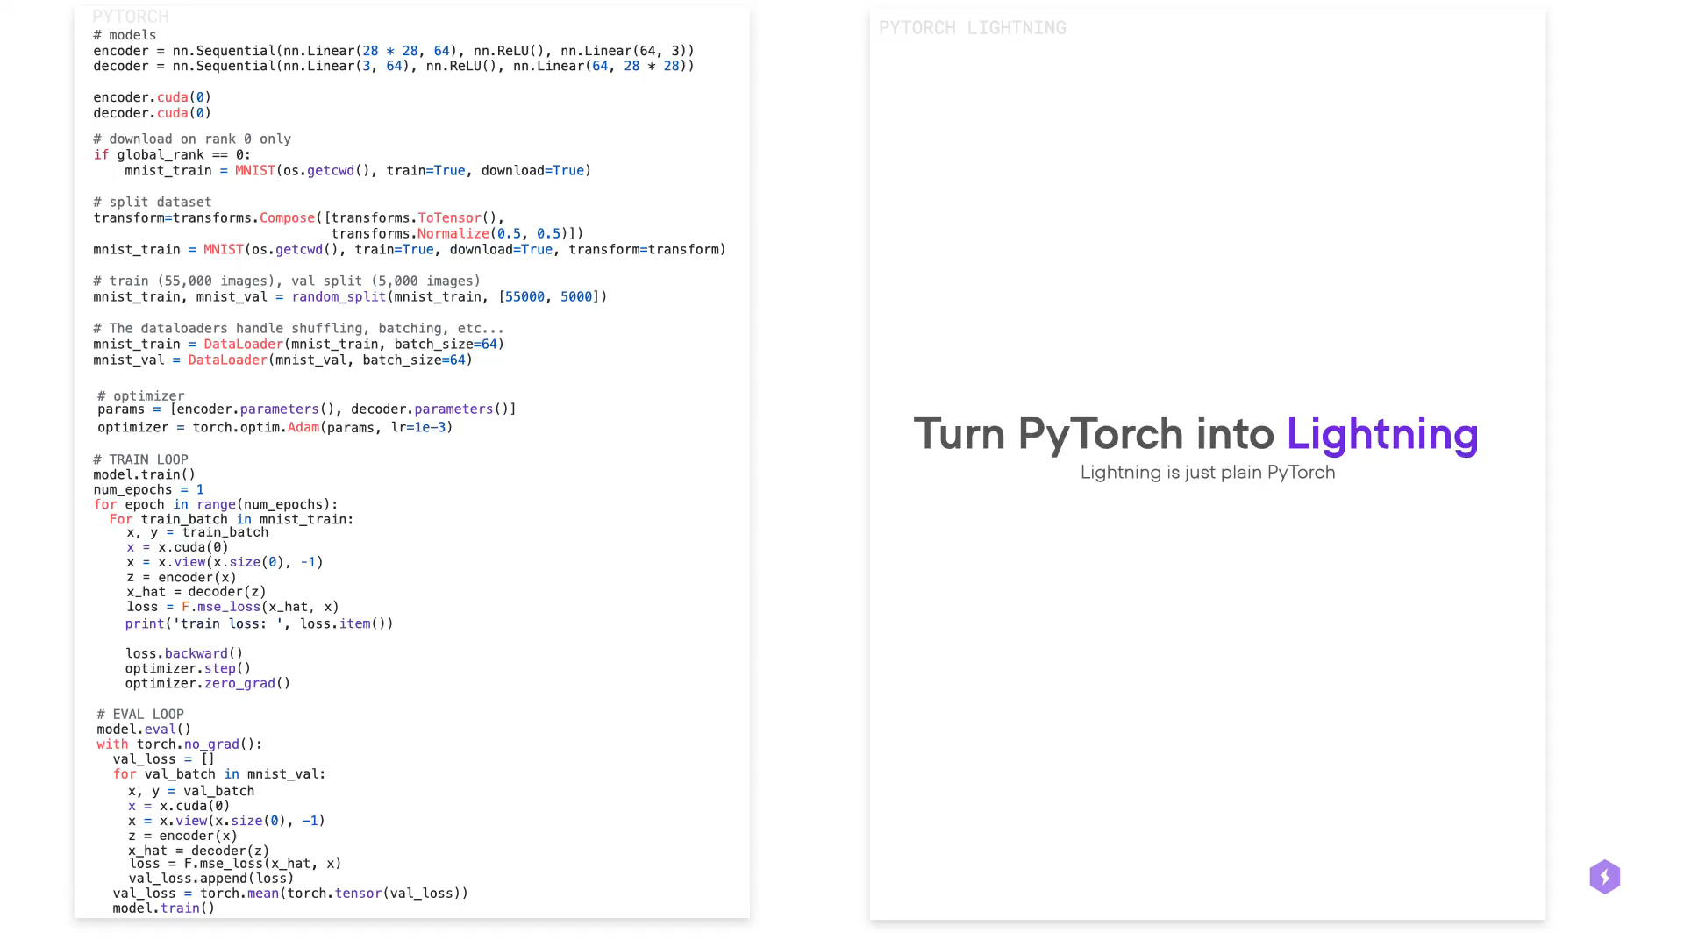

Slide 18
Why is PyTorch Lightning so cool?
Automatically logs loss and metrics
Automatically can adjust for cpu, gpu, and mps devices
Displays a progress bar and values during training
Has built-in checkpointing based on the validation set
Standardizes the setup for PyTorch code

Slide 19
Let’s Try It!

